Slide 1

Question Answering system

Slide 2
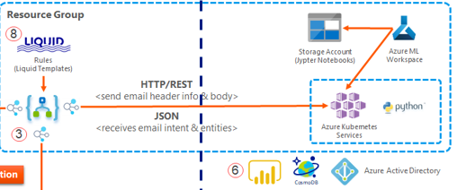
Architecture
Azure ML
Azure Container instance

Slide 3
First model workflow
Create and Deploy model
Create a Workspace
Register pretrained model for Deployment
Create Scoring Script
Create a YAML File for the Environment
Image Creation
Deploy the Image as a Web Service to Azure Container Instance
2. Test Deployed Webservice

Slide 4
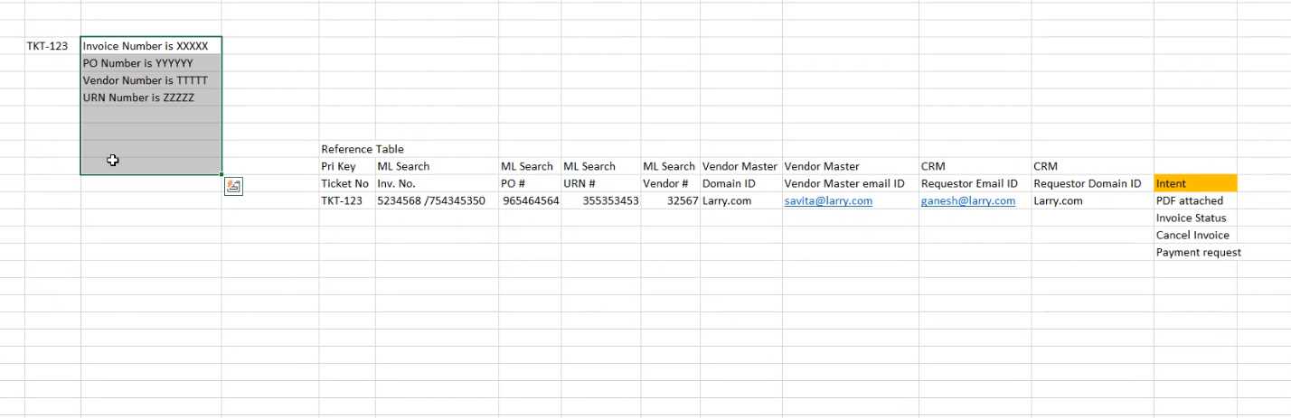
Requirement

Slide 5
Models suggested
Regex
URN | PO | Vendor no | Invoice that starts with INV
BiDaf
Deep Learning model
Customer no | Reference No | Document number | Invoice number | Request number

Slide 6
Invoice number prediction-confusion
Eg :the Purchase Order number for the invoice is 9904681 - which is identified as Invoice number
Multiple invoice number not identified
98954039-TKT-3647450-V3H3B9 is invoice number but in first case it is PO number
If the desired number we search is not present ,then it will try to pick up the whole sentence or some relevant number(like PO )because difficult to identify

Slide 7
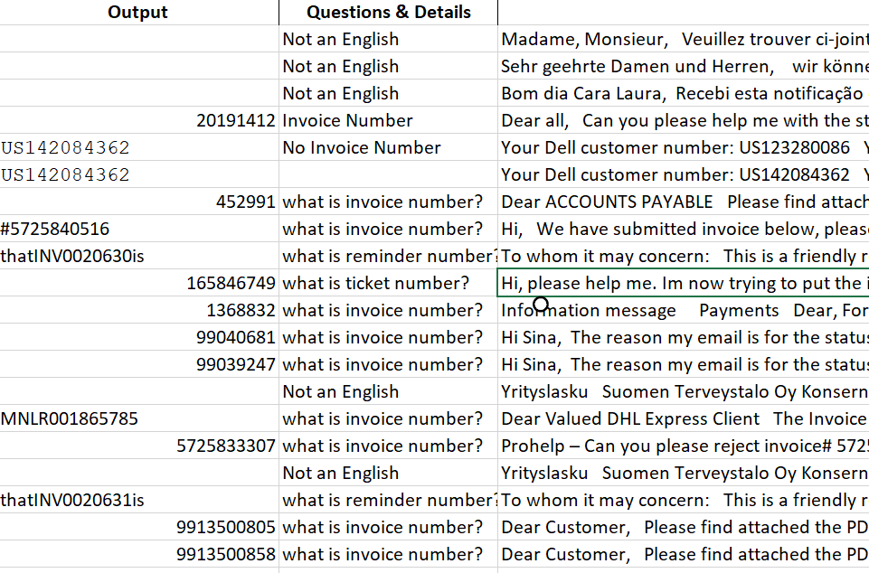
Bidaf attention model output -QA

Slide 8
Not capturing –large tables eg
Hi team, Hope my e-mail finds you well! Could you please check the below listed invoices from your Hewlett Packard Limited account and let me know if they have been approved and scheduled for payment? Thank you in advance! Invoice PO Number Doc Date Due Date PT Amount Currency 7740011002 80108709 10-Jan-19 11-Mar-19 NT60 925.48 GBP 6073542 98607667 21-Jun-19 21-Jul-19 NT30 26,617.50 USD 6073537 98826224 21-Jun-19 21-Jul-19 NT30 54,000.00 USD Kind regards, How did Andreea do for you today? (Click on icon below) Andreea Brotea Collections Analyst UK Ireland 40 311 317 029 hpe.com
Hi Team Please find the attached below mentioned Aditi Invoices for the month of October 2019 Supplier Name PO Number Invoice Date Invoice Number Invoice Amount Company Code Aditi Staffing India Private Limited 98954039 12-Nov-19 ASIPL/19-20/486 1,84,056 1,098 Aditi Staffing India Private Limited 98945861 12-Nov-19 ASIPL/19-20/487 1,26,107 1,098 Aditi Staffing India Private Limited 98910865 12-Nov-19 ASIPL/19-20/489 39,960 1,098 Aditi Staffing India Private Limited 98965526 12-Nov-19 ASIPL/19-20/493 51,802 1,098 Aditi Staffing India Private Limited 98913281 12-Nov-19 ASIPL/19-20/496 1,35,865 1,098 Aditi Staffing India Private Limited 98968525 12-Nov-19 ASIPL/19-20/503 4,23,469 1,098 Aditi Staffing India Private Limited 98969321 12-Nov-19 ASIPL/19-20/506 67,968 1,098 Aditi Staffing India Private Limited 98915221 12-Nov-19 ASIPL/19-20/508 1,15,062 1,098 Aditi Staffing India Private Limited 98968589 12-Nov-19 ASIPL/19-20/510 1,38,600 1,098 Aditi Staffing India Private Limited 98968563 12-Nov-19 ASIPL/19-20/517 94,230 1,098 Aditi Staffing India Private Limited 98965386 12-Nov-19 ASIPL/19-20/520 2,72,743 1,098 Aditi Staffing India Private Limited 98934780 12-Nov-19 ASIPL/19-20/532 58,292 1,098 Aditi Staffing India Private Limited 98915370 12-Nov-19 ASIPL/19-20/536 1,58,970 1,098 Aditi Staffing India Private Limited 98934854 12-Nov-19 ASIPL/19-20/538 1,66,946 1,098 Aditi Staffing India Private Limited 98919360 12-Nov-19 ASIPL/19-20/544 1,20,3

Slide 10
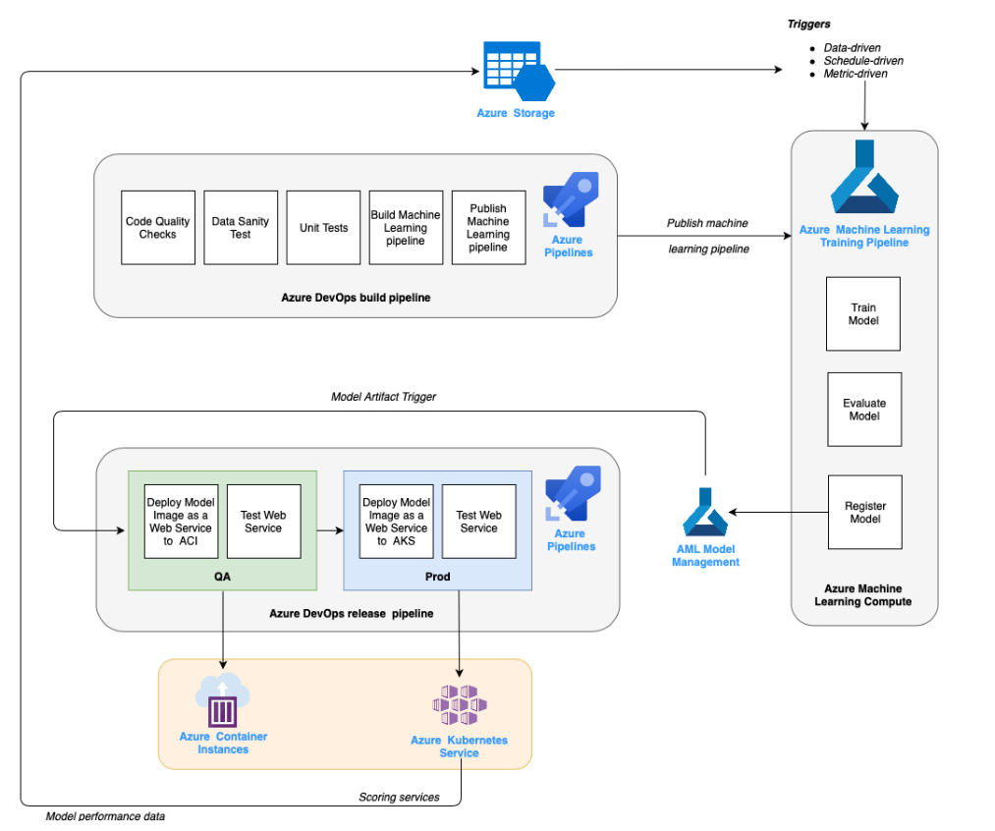
Mlops flow

Slide 11
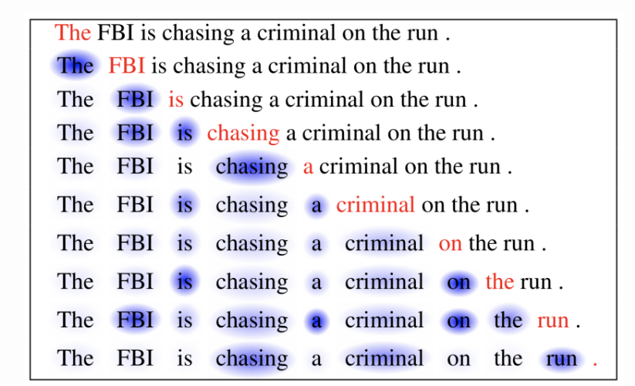
Bi-Directional Attention Flow (BiDAF)
LSTM-Deep learning model in Pytorch

Slide 12
Azure Ml->Pkl file
Pkl->file to predict without azure ml

